Slide 1
Movie Recommender System using Autoencoders
Team Members ⇒
18UCC063 : Akhil Kashyap
18UCC101 : Himanshu Chahar
18UCC169 : Shivansh Jain

Slide 2

Problem Statement
Advancement in digital technologies ⇒ people's towering reliance on the Internet
Issue of Knowledge Overload
Drowned in a massive pool of data
Need to store, prioritize, and efficiently deliver best-suited information to the users

Slide 3

Why Recommender Systems?
Takes in vast amounts of data (fixed or dynamic)
Processes the same
Provides the users with a subset of results that are actually needed and beneficial for that user
Hence, it plays a vital role in solving problem of Knowledge/Data Overload

Slide 4
Our Goals & Objectives

Slide 5
Objectives
Implement a “Recommender Search Model using Autoencoders”
Study about different architectures of Autoencoders needed to build an efficient and accurate model
Train & Test the different models on the chosen Dataset
Compare them on various criteria & choose the one best suited for our purpose
Predict Movies, Save Time!

Slide 6
Literature Review

Slide 7
Deep Learning based Recommender System: A Survey and New Perspectives
Discussion on the concepts and terminologies related to Deep learning and Recommender Systems.
Survey on various deep learning models
Property of neural architecture ⇒
end-to-end differentiable
produce relevant inductive biases
Pros and Cons of Deep learning is also discussed

Slide 8
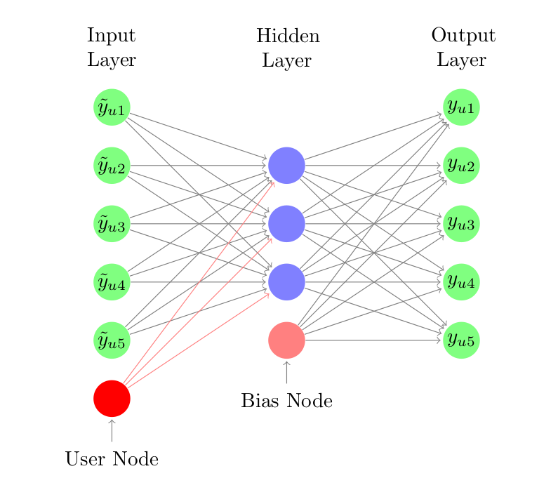
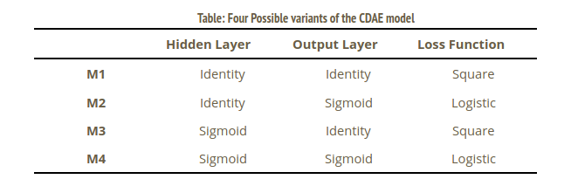
Collaborative Denoising Auto-Encoders for Top-N Recommender Systems
Encoder is based on the concept of Denoising Autoencoder.
Latent vector is what makes CDAE to be a much better model among other recommender models
Non-linear functions helps in increasing the model’s representation ability and hence increasing the accuracy of the recommender system
Datasets used for the model ⇒
MovieLens 10M
Netflix
Yelp Dataset.
Distinct combinations of the elements resulted in distinct versions of the CDAE model.

Slide 9
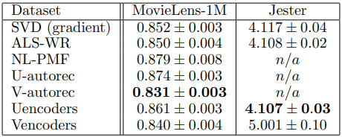
Collaborative Filtering with Stacked Denoising AutoEncoders and Sparse Inputs
Aimed at developing strategy which is used to implement collaborative filtering using SDAE.
Input used is sparse in nature
Dataset used ⇒
Jester Joke dataset
MovieLens 1M dataset
This paper there have defined two Encoders ⇒
Uencoder ⇒ used to learn the user representations
Vencoder ⇒ used to learn item representations
The excellent performance of Autoencoders is inferred
In terms of errors, the research was insufficient to comment about

Slide 10
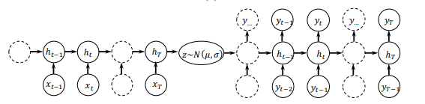
Collaborative Variational Autoencoder for Recommender Systems
CVAE is a Bayesian Generative Model.
CVAE connects the different types of multimedia for recommender systems because of its stochastic distribution in latent space rather than observation space.
In the case of CVAE the noise level is learned automatically by the inference network.
Dataset used ⇒
Citeulike-a
Citeulike-b

Slide 11
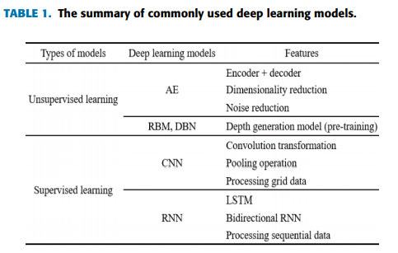
A Survey of Recommender Systems Based on Deep Learning
Discussion on the various topics of research in the field of deep learning based-recommender systems (RS)
Features & characteristics of Deep Learning Based methods in:
Content-based RS
Collaborative Filtering RS
Hybrid RS
Social Network-based RS
Context-aware RS
Some other major models discussed:
AutoEncoders (AE)
Restricted Boltzmann machine (RBM)
Recurrent Neural Networks (RNN)
Convolutional Neural Networks (CNN)
Deep Belief Network (DBN)

Slide 12
Methods Implemented

Slide 13
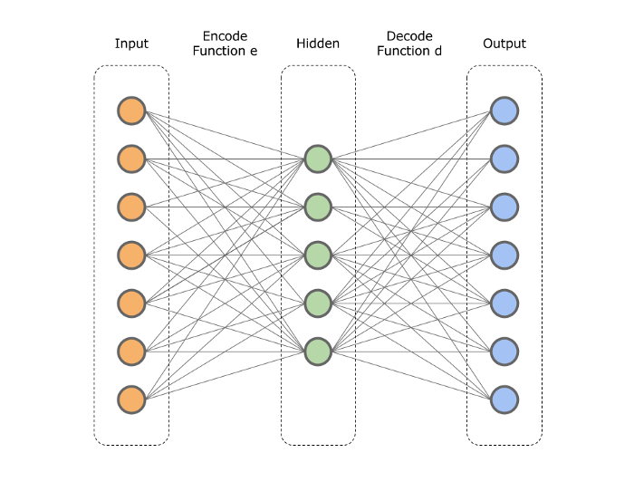
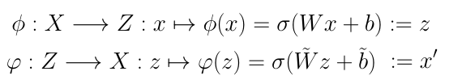
AUTOENCODERS
Unsupervised learning technique
Mostly used in the field of collaborative filtering
Used to encode a set of input data which is basically used for dimensionality reduction.
Architecture for an autoencoder model ⇒
Input layer
One hidden layer
Output layer
Architecture
Mathematical function for mapping

Slide 14
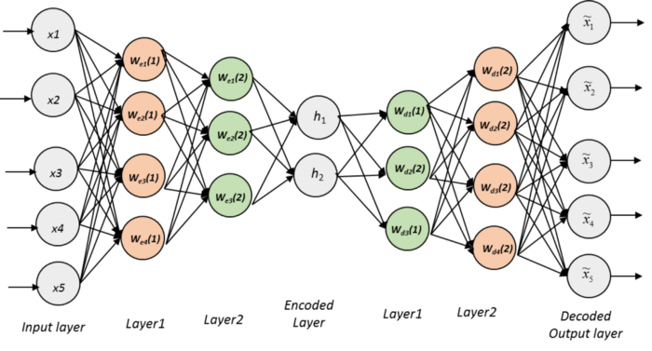
STACKED AUTOENCODERS
A Neural Network model; made up of many layers of sparse autoencoders
Output from each layer acts as Input for the next layer
Train layers (Unsupervised algo) ⇒ Tune layers (Supervised approach)
Three major steps:
Train AE using input data ⇒ Obtain learned data
Output from previous layer (learned data)
⇒ Input for next hidden layer
Process repeated till all layers are trained
Backpropagation Algorithm :
To minimise Cost function
Updation of weights ⇒ finer tuning

Slide 15
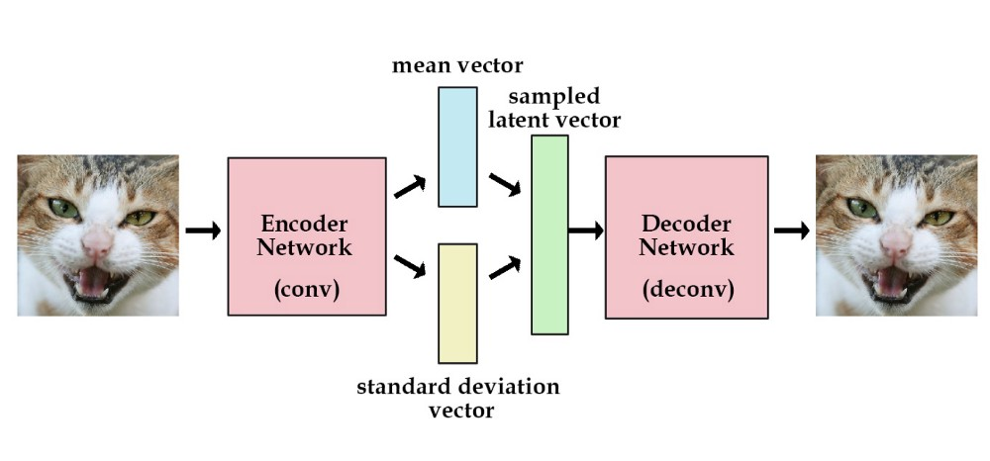
VARIATIONAL AUTOENCODERS
Variational Autoencoders (VAEs) are powerful generative models
Principle: Input not mapped to a fixed vector but mapped to a Distribution
Bottleneck vector is replaced by two separate vectors:
One for distribution’s Mean
Other for distribution’s Standard Deviation
The two vectors act as parameters for a random variable vector

Slide 16
Results

Slide 17
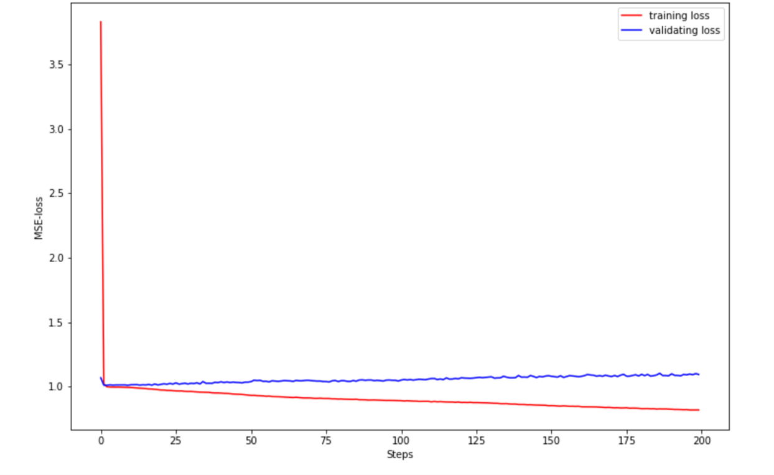
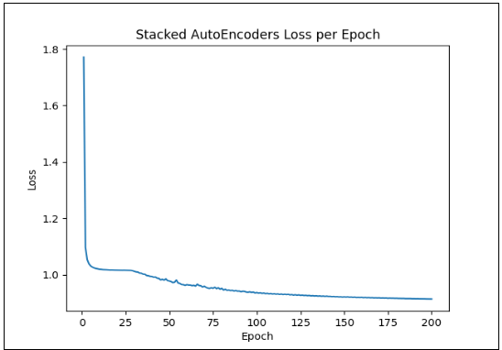
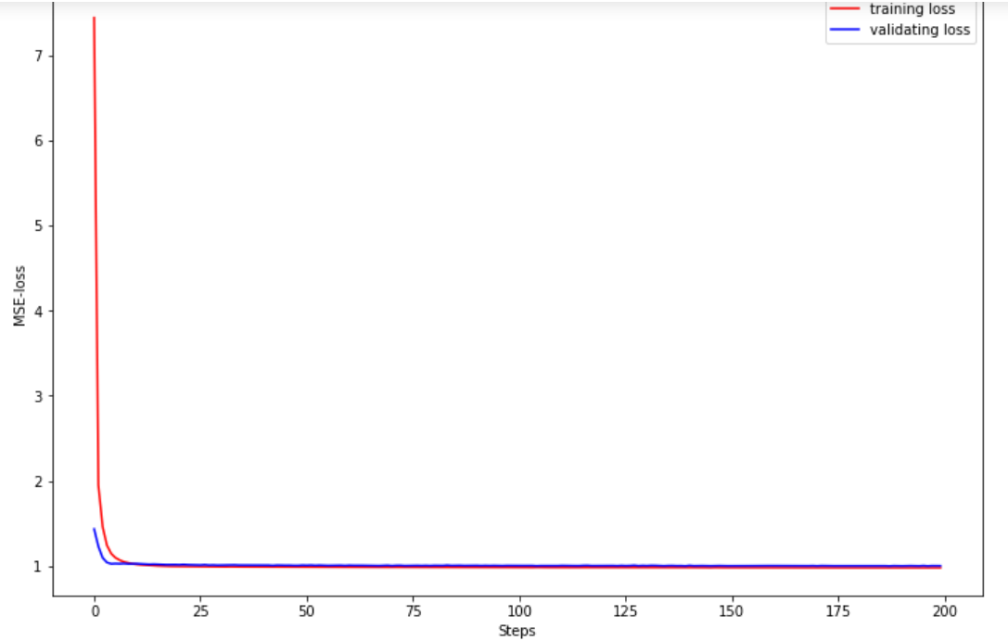
Loss vs Epoch graph for the methods Implemented
Autoencoder
Stacked Autoencoder
Variational Autoencoder
Initially the loss for the model is on the higher side
With increasing epoch ⇒ loss gradually decreases

Slide 18
Test Loss for the methods implemented
 | AutoEncoder | Stacked AutoEncoder | Variational AutoEncoder
Test Loss | 1.0829 | 0.9456 | 0.9927
Lesser is the Average Test Loss ⇒ better is our model
⇒ Stacked AutoEncoder performs the best out of the three models

Slide 19
Why Stacked Autoencoder performs better?
Better performance due to the process of ‘Stacking’
Stacking ensures that at every stage, our data is represented in lower/ higher dimensional space effectively.
Training of hidden layers using unsupervised algorithms and then tuning with the help of supervised algorithms
Overfitting in case of Autoencoder

Slide 20
References

Slide 21
References
https://medium.com/snipfeed/how-variational-autoencoders-make-classical-recommender-systems-obsolete-4df8bae51546
https://towardsdatascience.com/recommendation-system-series-part-6-the-6-variants-of-autoencoders-for-collaborative-filtering-bd7b9eae2ec7
https://dl.acm.org/doi/10.1145/3285029
https://hal.inria.fr/hal-01256422v1
https://www.semanticscholar.org/paper/A-Survey-of-Recommender-Systems-Based-on-Deep-Mu/5b16da7ad7afa38eab8aa30c3853c8d7ca5728e4
https://cseweb.ucsd.edu/classes/fa17/cse291-b/reading/p305-li.pdf
https://link.springer.com/article/10.1007/s10462-018-9654-y
https://medium.com/@venkatakrishna.jonnalagadda/sparse-stacked-and-variational-autoencoder-efe5bfe73b64#:~:text=A%20stacked%20autoencoder%20is%20a,of%20the%20successive%20hidden%20layer
https://arxiv.org/pdf/1707.07435.pdf

Slide 22
Thank You!

